Slide 1
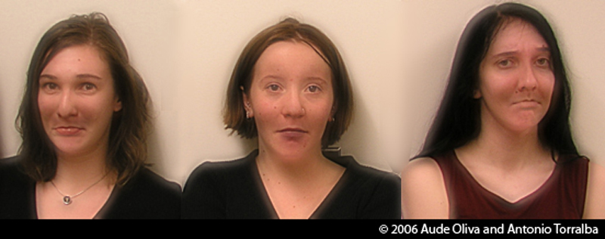
Lecture 1: Images and image filtering
Computer Vision
Hybrid Images, Oliva et al., http://cvcl.mit.edu/hybridimage.htm

Slide 2
Reading
Szeliski, Chapter 3.1-3.2

Slide 3

What is an image?

Slide 4


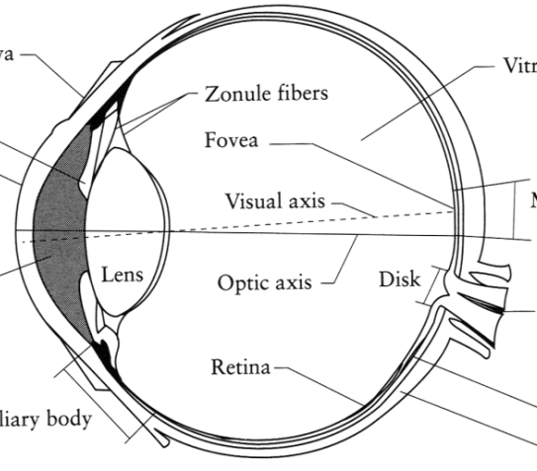
What is an image?
Digital Camera
We’ll focus on these in this class
(More on this process later)
The Eye
Source: A. Efros

Slide 5
What is an image?
A grid (matrix) of intensity values
(common to use one byte per value: 0 = black, 255 = white)
255 | 255 | 255 | 255 | 255 | 255 | 255 | 255 | 255 | 255 | 255 | 255
255 | 255 | 255 | 255 | 255 | 255 | 255 | 255 | 255 | 255 | 255 | 255
255 | 255 | 255 | 20 | 0 | 255 | 255 | 255 | 255 | 255 | 255 | 255
255 | 255 | 255 | 75 | 75 | 75 | 255 | 255 | 255 | 255 | 255 | 255
255 | 255 | 75 | 95 | 95 | 75 | 255 | 255 | 255 | 255 | 255 | 255
255 | 255 | 96 | 127 | 145 | 175 | 255 | 255 | 255 | 255 | 255 | 255
255 | 255 | 127 | 145 | 175 | 175 | 175 | 255 | 255 | 255 | 255 | 255
255 | 255 | 127 | 145 | 200 | 200 | 175 | 175 | 95 | 255 | 255 | 255
255 | 255 | 127 | 145 | 200 | 200 | 175 | 175 | 95 | 47 | 255 | 255
255 | 255 | 127 | 145 | 145 | 175 | 127 | 127 | 95 | 47 | 255 | 255
255 | 255 | 74 | 127 | 127 | 127 | 95 | 95 | 95 | 47 | 255 | 255
255 | 255 | 255 | 74 | 74 | 74 | 74 | 74 | 74 | 255 | 255 | 255
255 | 255 | 255 | 255 | 255 | 255 | 255 | 255 | 255 | 255 | 255 | 255
255 | 255 | 255 | 255 | 255 | 255 | 255 | 255 | 255 | 255 | 255 | 255
=

Slide 6
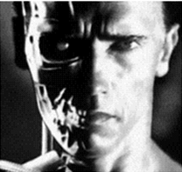
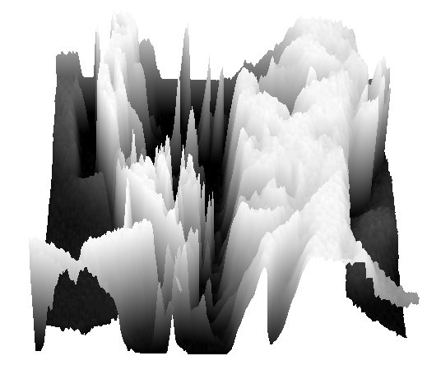
What is an image?
We can think of a (grayscale) image as a function, f, from R² to R:
f (x,y) gives the intensity at position (x,y)
A digital image is a discrete (sampled, quantized) version of this function
f (x, y)
x
y
snoop
3D view

Slide 7
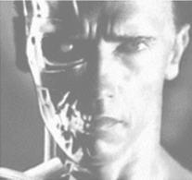
Image transformations
As with any function, we can apply operators to an image
Today we’ll talk about a special kind of operator, convolution (linear filtering)
g (x,y) = f (x,y) + 20
g (x,y) = f (-x,y)

Slide 8
Filters
Filtering
Form a new image whose pixels are a combination of the original pixels
Why?
To get useful information from images
E.g., extract edges or contours (to understand shape)
To enhance the image
E.g., to remove noise
E.g., to sharpen and “enhance image” a la CSI

Slide 9
Canonical Image Processing problems
Image Restoration
denoising
deblurring
Image Compression
JPEG, JPEG2000, MPEG..
Computing Field Properties
optical flow
disparity
Locating Structural Features
corners
edges

Slide 10
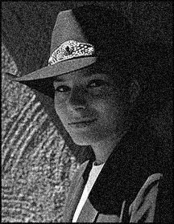
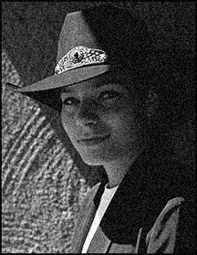

Question: Noise reduction
Given a camera and a still scene, how can you reduce noise?
Take lots of images and average them!
What’s the next best thing?
Source: S. Seitz
Notes:
Answer: take lots of images, average them

Slide 11
Image filtering
Modify the pixels in an image based on some function of a local neighborhood of each pixel
10
5
3
Some function
4
5
1
7
1
1
7
Local image data
Modified image data
Source: L. Zhang

Slide 12
Linear filtering
One simple version of filtering: linear filtering (cross-correlation, convolution)
Replace each pixel by a linear combination (a weighted sum) of its neighbors
The prescription for the linear combination is called the “kernel” (or “mask”, “filter”)
10
5
3
0
0
0
4
6
1
0
0.5
0
8
1
1
8
0
1
0.5
Local image data
kernel
Modified image data
Source: L. Zhang

Slide 13
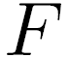
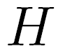

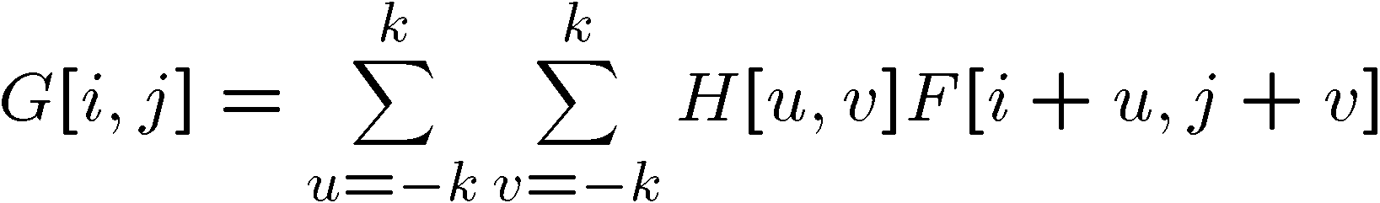
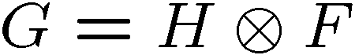
Cross-correlation
Let be the image, be the kernel (of size 2k+1 x 2k+1), and be the output image
Can think of as a “dot product” between local neighborhood and kernel for each pixel
This is called a cross-correlation operation:

Slide 14
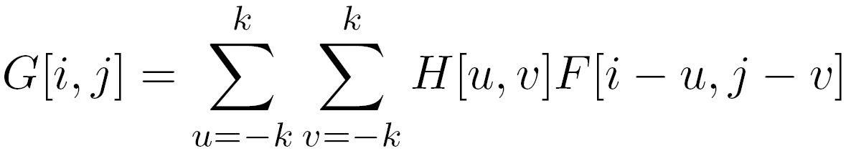
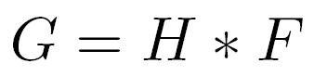
Convolution
Same as cross-correlation, except that the kernel is “flipped” (horizontally and vertically)
Convolution is commutative and associative
This is called a convolution operation:

Slide 15
1D Demo

Slide 16



Convolution
Adapted from F. Durand

Slide 17

Mean filtering
0 | 0 | 0 | 0 | 0 | 0 | 0 | 0 | 0 | 0
0 | 0 | 0 | 0 | 0 | 0 | 0 | 0 | 0 | 0
0 | 0 | 0 | 90 | 90 | 90 | 90 | 90 | 0 | 0
0 | 0 | 0 | 90 | 90 | 90 | 90 | 90 | 0 | 0
0 | 0 | 0 | 90 | 90 | 90 | 90 | 90 | 0 | 0
0 | 0 | 0 | 90 | 0 | 90 | 90 | 90 | 0 | 0
0 | 0 | 0 | 90 | 90 | 90 | 90 | 90 | 0 | 0
0 | 0 | 0 | 0 | 0 | 0 | 0 | 0 | 0 | 0
0 | 0 | 90 | 0 | 0 | 0 | 0 | 0 | 0 | 0
0 | 0 | 0 | 0 | 0 | 0 | 0 | 0 | 0 | 0
 | 0 | 10 | 20 | 30 | 30 | 30 | 20 | 10
 | 0 | 20 | 40 | 60 | 60 | 60 | 40 | 20
 | 0 | 30 | 60 | 90 | 90 | 90 | 60 | 30
 | 0 | 30 | 50 | 80 | 80 | 90 | 60 | 30
 | 0 | 30 | 50 | 80 | 80 | 90 | 60 | 30
 | 0 | 20 | 30 | 50 | 50 | 60 | 40 | 20
 | 10 | 20 | 30 | 30 | 30 | 30 | 20 | 10
 | 10 | 10 | 10 | 0 | 0 | 0 | 0 | 0
*
=
1 | 1 | 1
1 | 1 | 1
1 | 1 | 1

Slide 18
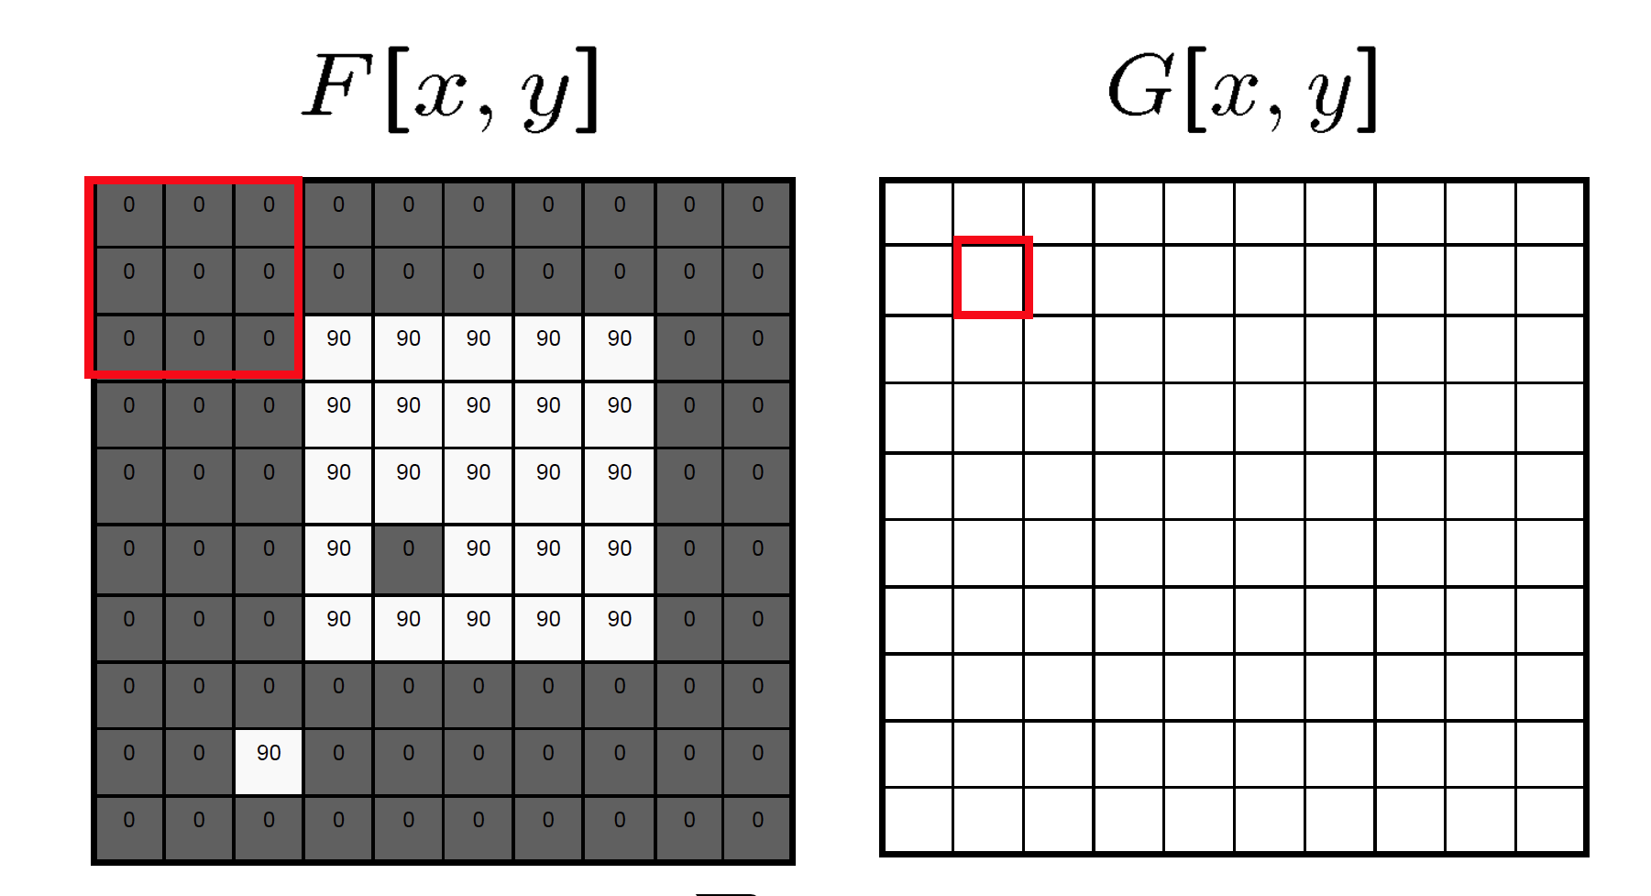
Mean filtering/Moving average

Slide 19
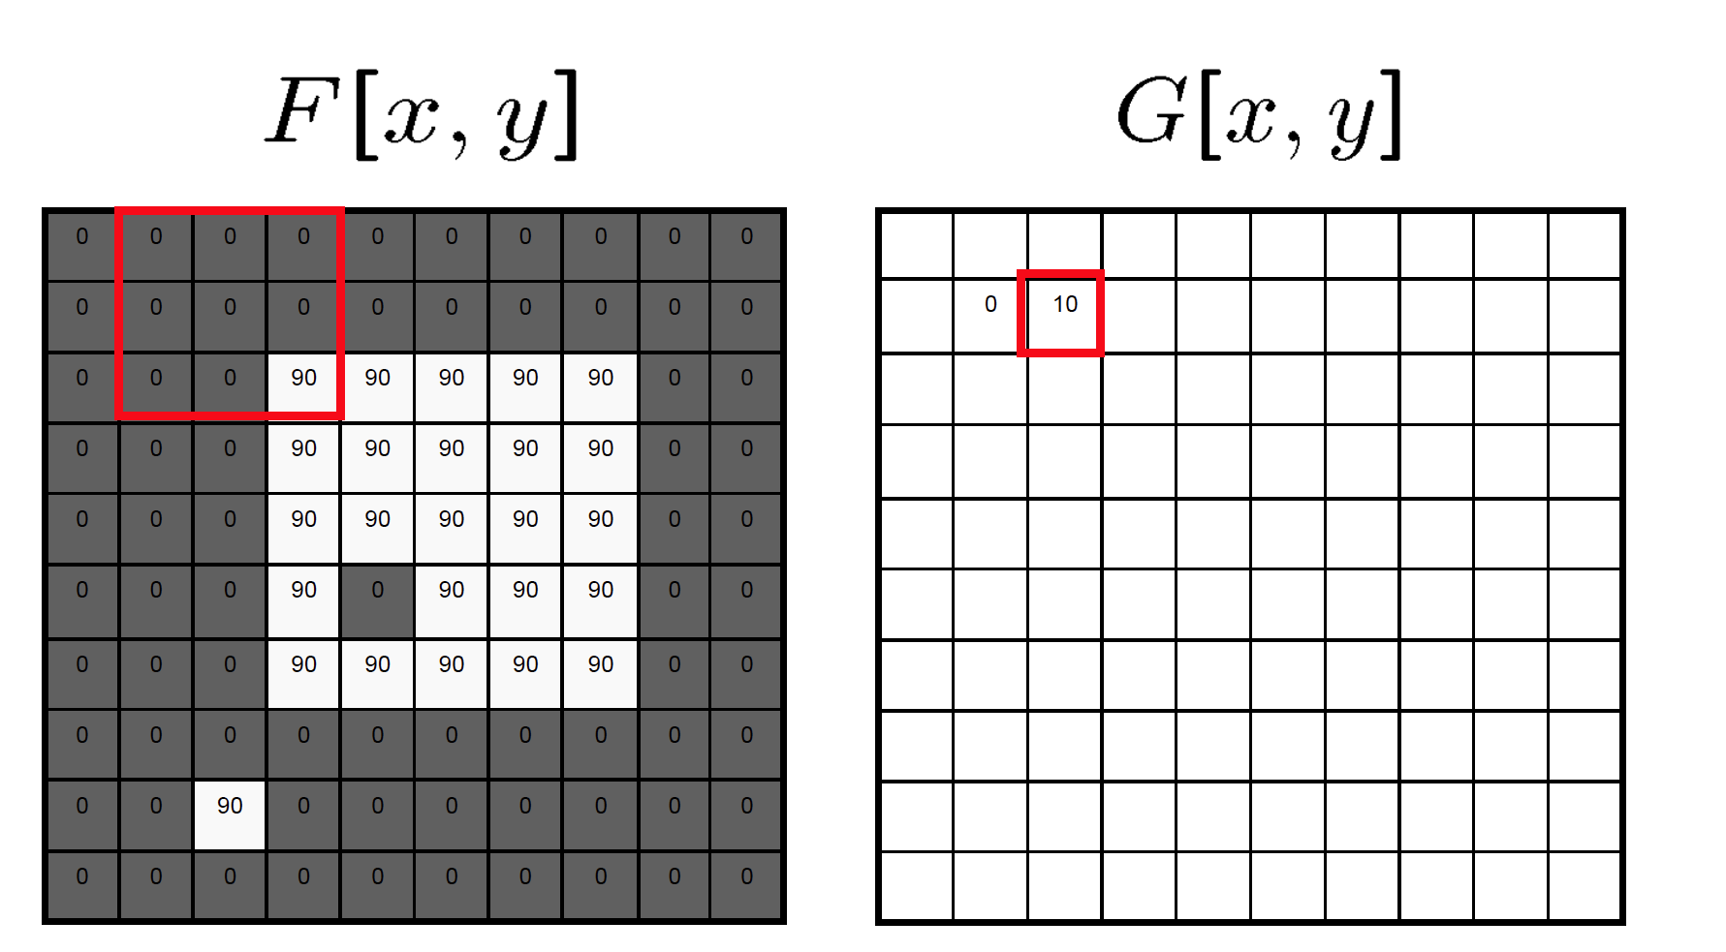
Mean filtering/Moving average

Slide 20

Mean filtering/Moving average

Slide 21
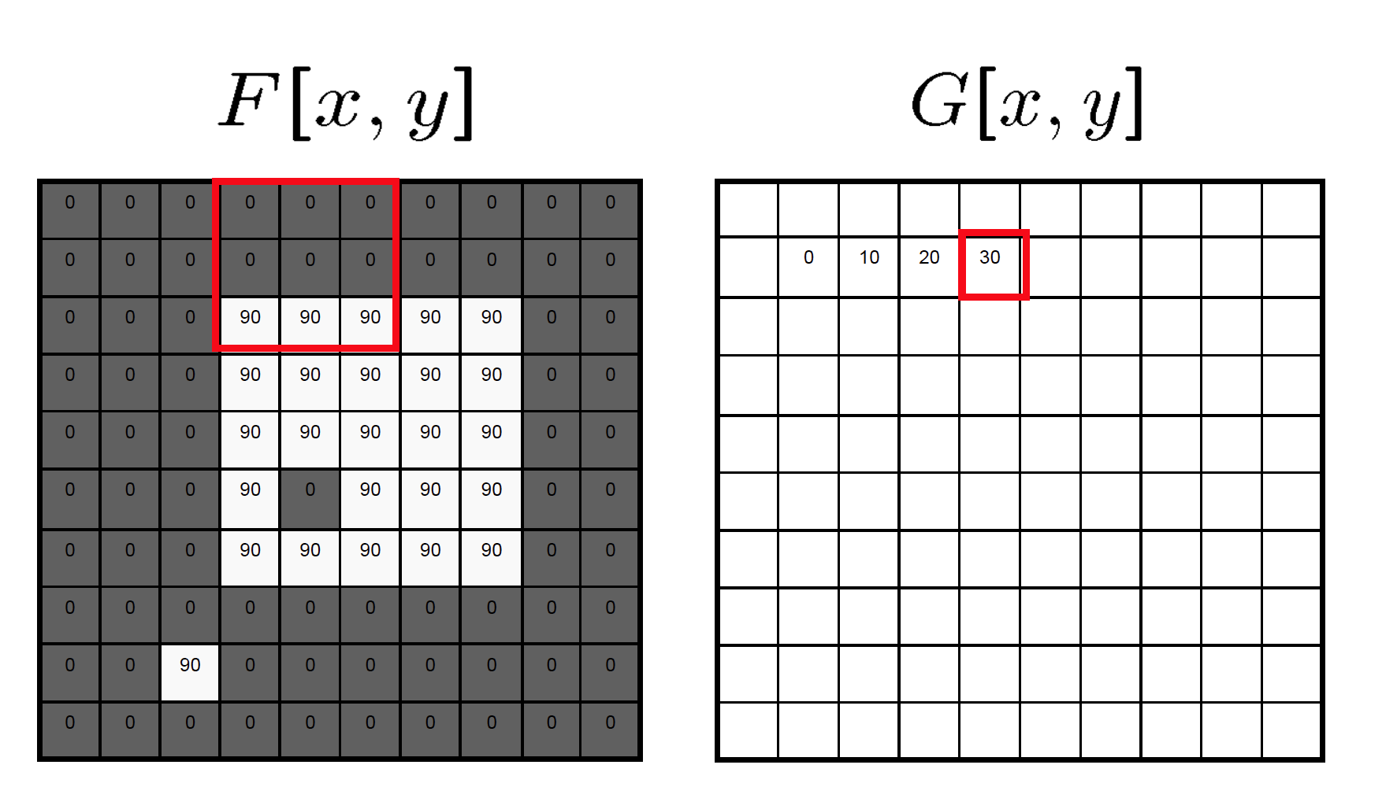
Mean filtering/Moving average

Slide 22
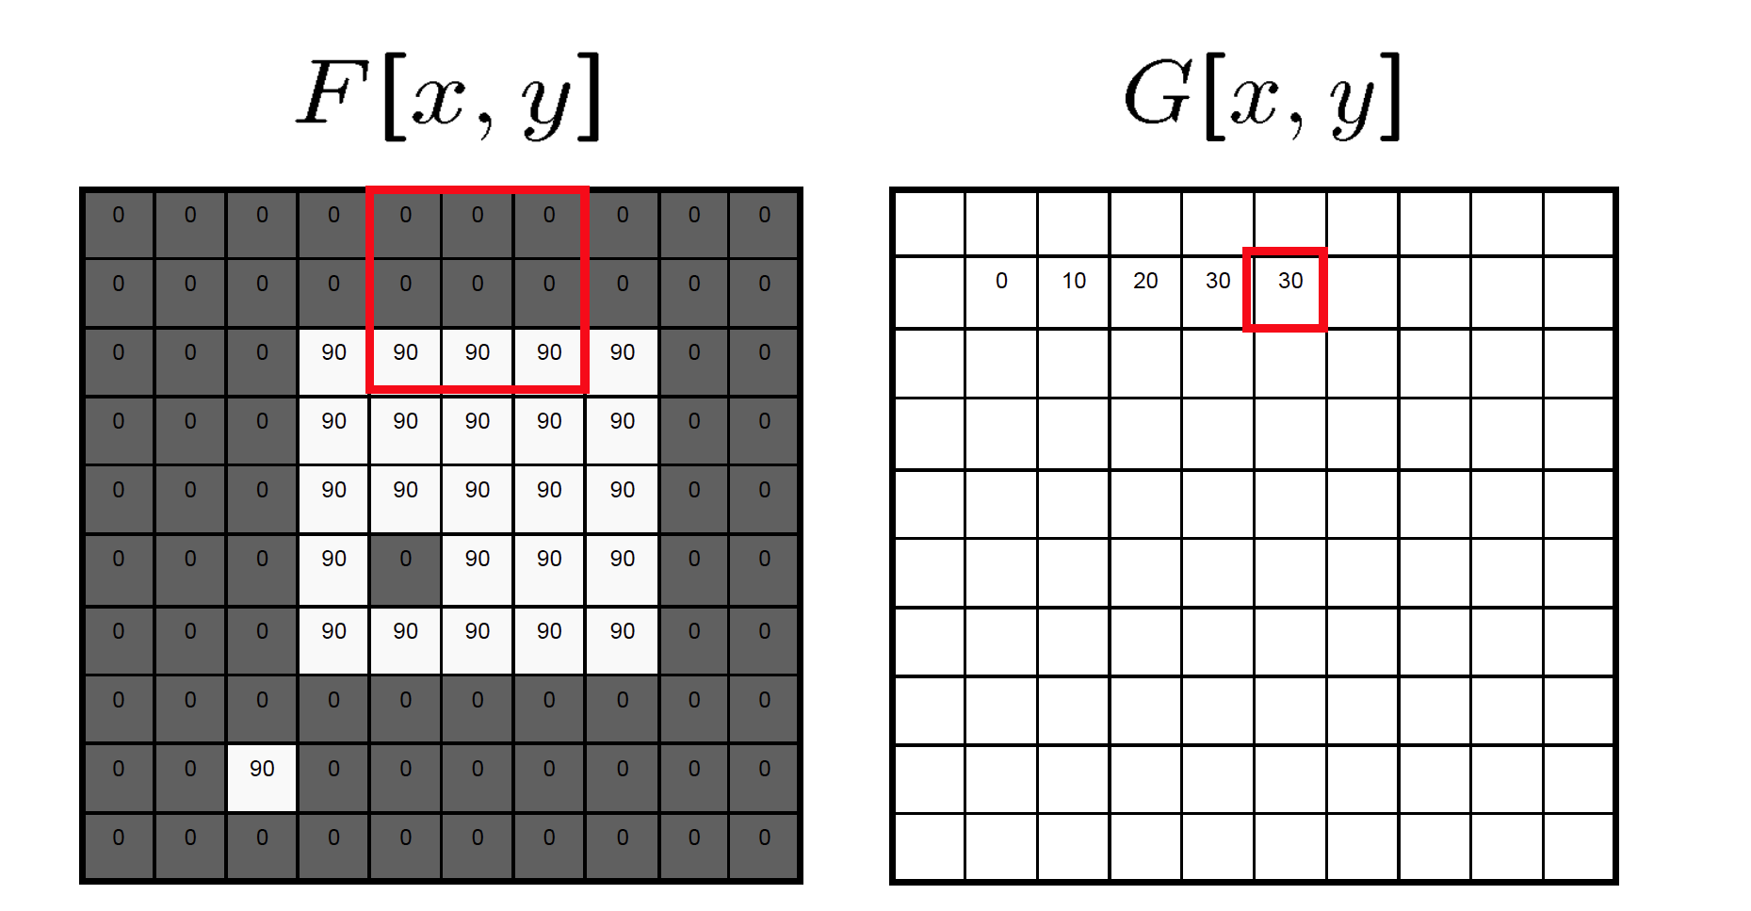
Mean filtering/Moving average

Slide 23
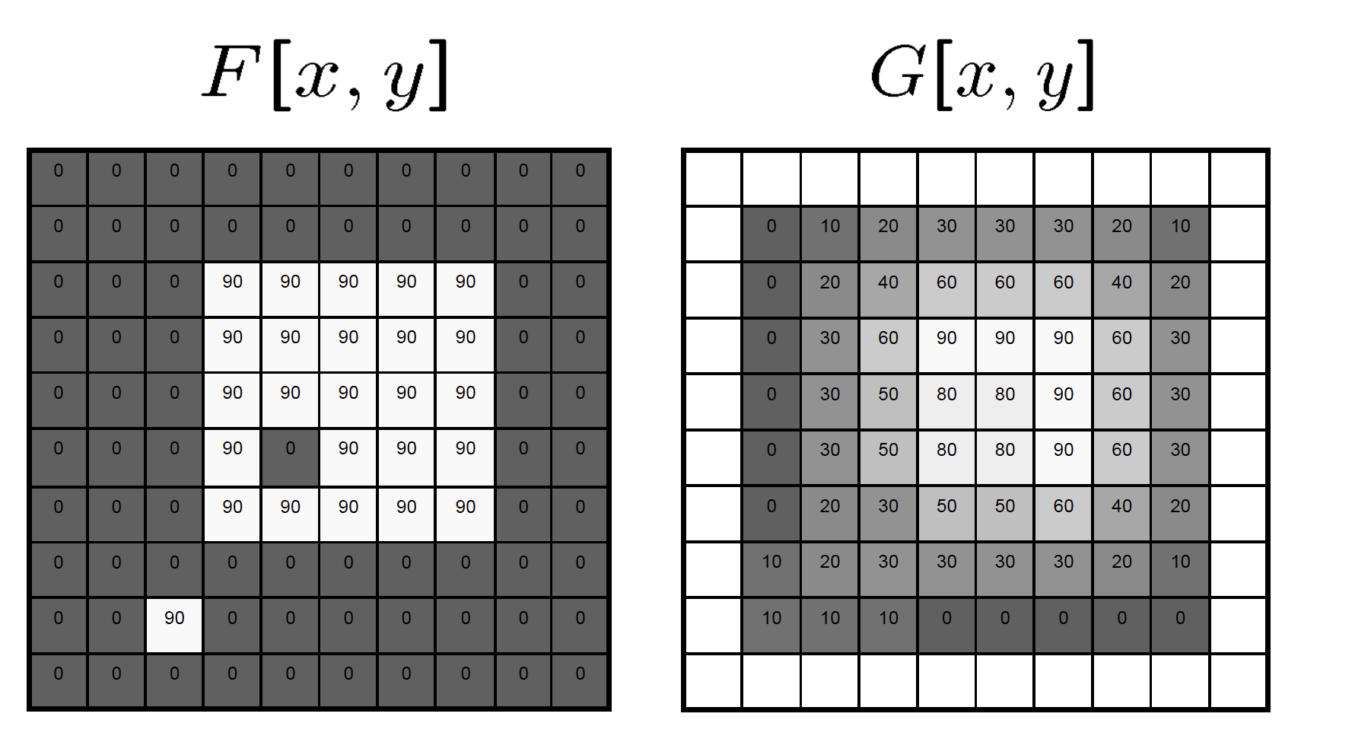
Mean filtering/Moving average

Slide 24
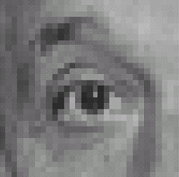
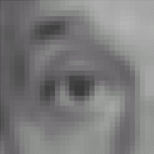

Example filters
1
1
1
1
1
1
1
1
1
Original
Blur (with a
box filter)
Source: D. Lowe

Slide 25
Linear filters: examples
*
0
0
0
=
0
1
0
0
0
0
Original
Identical image
Source: D. Lowe

Slide 26
Linear filters: examples
*
0
0
0
=
1
0
0
0
0
0
Original
Shifted left
By 1 pixel
Source: D. Lowe

Slide 27
Linear filters: examples
*
1
1
1
=
1
1
1
1
1
1
Original
Blur (with a mean filter)
Source: D. Lowe

Slide 28
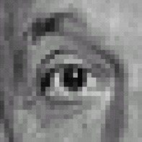



Linear filters: examples
*
0
0
0
-
1
1
1
=
0
2
0
1
1
1
0
0
0
1
1
1
Sharpening filter (accentuates edges)
Original
Source: D. Lowe

Slide 29
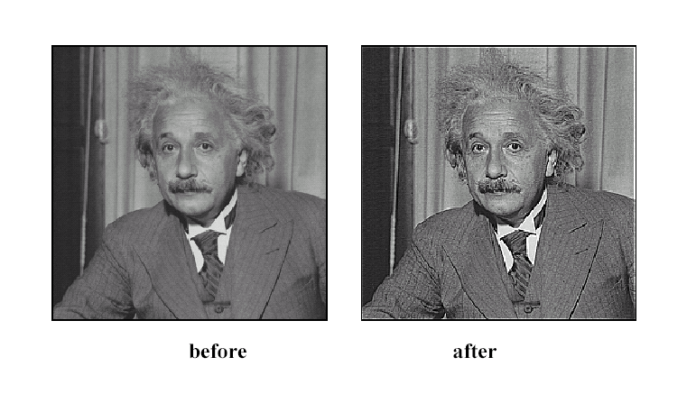
Sharpening
Source: D. Lowe

Slide 30
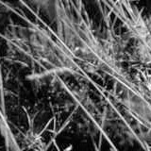
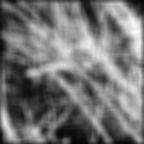
Smoothing with box filter revisited
Source: D. Forsyth
Notes:
I always walk through the argument on the left rather carefully; it gives some insight into the
significance of impulse responses or point spread functions.

Slide 31
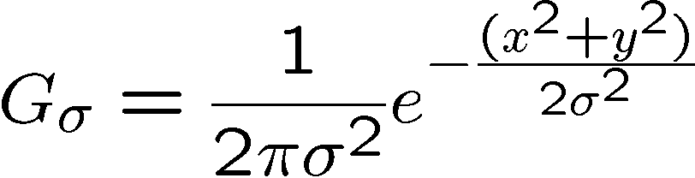
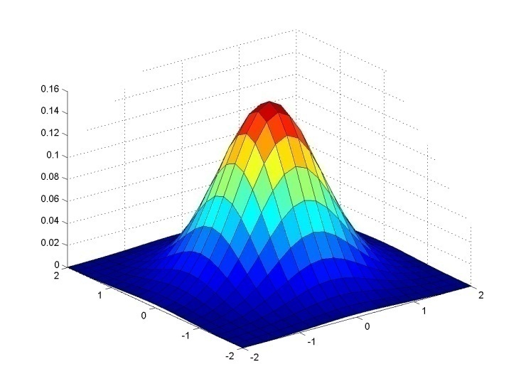
Gaussian Kernel
0.003 0.013 0.022 0.013 0.003
0.013 0.059 0.097 0.059 0.013
0.022 0.097 0.159 0.097 0.022
0.013 0.059 0.097 0.059 0.013
0.003 0.013 0.022 0.013 0.003
5 x 5, σ = 1
Constant factor at front makes volume sum to 1 (can be ignored, as we should re-normalize weights to sum to 1 in any case)
Source: C. Rasmussen

Slide 32
Gaussian Kernel
Source: C. Rasmussen

Slide 33
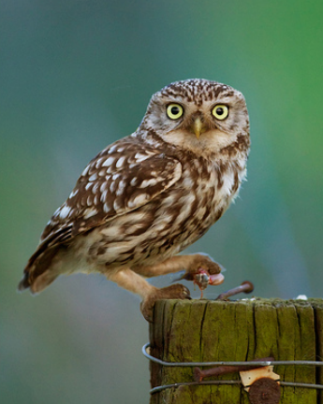
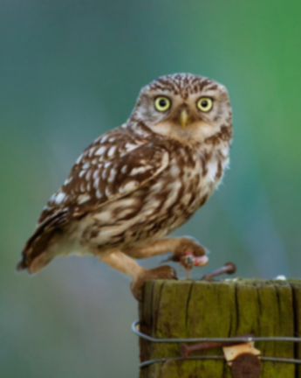








Gaussian filters
= 1 pixel
= 5 pixels
= 10 pixels
= 30 pixels

Slide 34
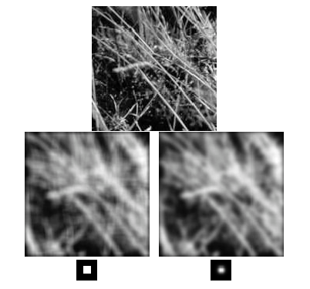
Mean vs. Gaussian filtering

Slide 35



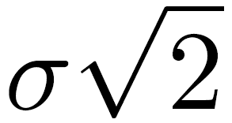
Gaussian filter
Removes “high-frequency” components from the image (low-pass filter)
Convolution with self is another Gaussian
Convolving twice with Gaussian kernel of width = convolving once with kernel of width
*
=
Source: K. Grauman
Notes:
Linear vs. quadratic in mask size

Slide 36

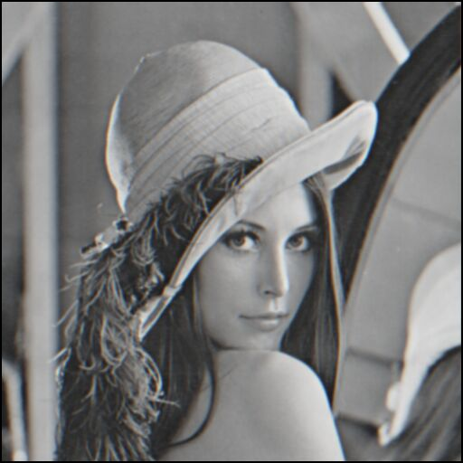
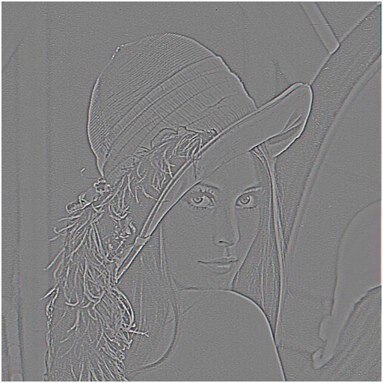

Sharpening revisited
What does blurring take away?
–
=
original
smoothed (5x5)
detail
(This “detail extraction” operation is also called a high-pass filter)
Let’s add it back:
+ α
=
original
detail
sharpened
Source: S. Lazebnik

Slide 37
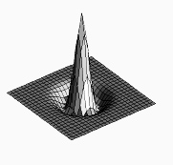

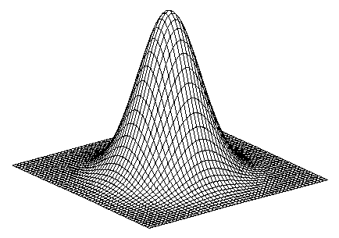
Sharpen filter
blurred image
image
unit impulse (identity)
scaled impulse
Gaussian
Laplacian of Gaussian
Notes:
f + a(f - f * g) = (1+a)f-af*g = f*((1+a)e-g)

Slide 38

Sharpen filter
unfiltered
filtered

Slide 39
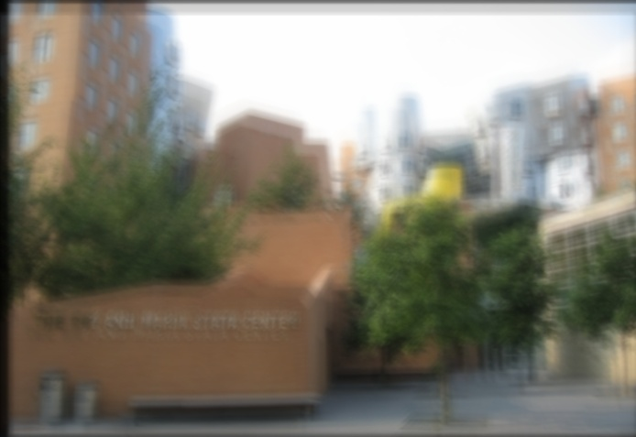
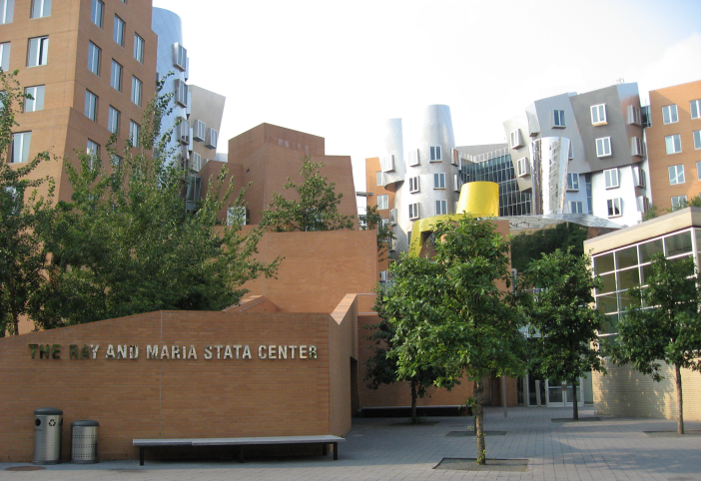
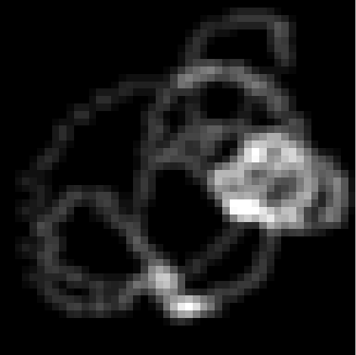
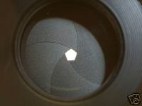


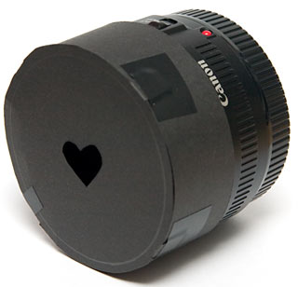
“Optical” Convolution
Camera shake
=
*
Source: Fergus, et al. “Removing Camera Shake from a Single Photograph”, SIGGRAPH 2006
Bokeh: Blur in out-of-focus regions of an image.
Source: http://lullaby.homepage.dk/diy-camera/bokeh.html

Slide 40
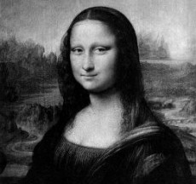
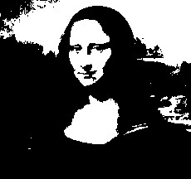
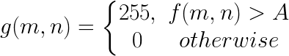
Filters: Thresholding

Slide 41
Linear filters
Is thresholding a linear filter?

Slide 42
Questions?
Spatial-Invariant VS Spatial-Aware
Local VS Global

